Slide 1

AI and the Environment: An Introduction to machine learning for environmental scientists

Slide 2
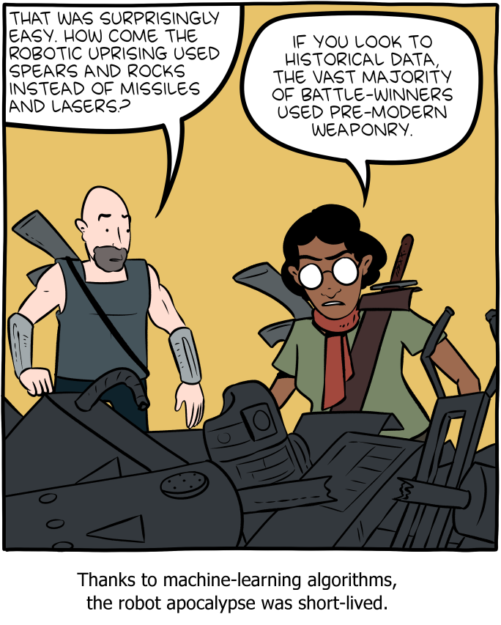
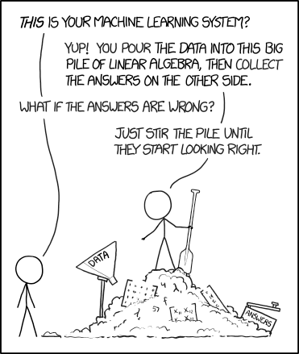
Machine Learning
¹XKCD, ²SMBC

Slide 3
The Course
Day 1:
Lecture 1 : What is Machine Learning and how can we use it.
Lecture 2: Simple Machine Learning methods
Practical 1: Linear Regression
Day 2:

Slide 4
What is AI?
Artificial Intelligence (AI) is generally a useless term that describes anything that attempts to replicate a level of intelligence only seen in humans.
It’s generally used as a buzz word that doesn’t mean very much to attract attention. It worked for this course….
Machine learning is something that is used to replicate human intelligence. Or even perform above it.

Slide 5
What is Machine Learning?
Machine Learning (ML) is the current approach to performing tasks that replicate human intelligence.
ML is almost entirely algorithms based on maths.
They use a variety of mathematical methods to make predictions.
The learning aspect of it comes from their ability to adjust their predictions based on the data.
They “learn” to make better predictions by adjusting their internal maths.

Slide 6
What is Deep Learning?
Deep Learning (DL) is a particular form of ML that utilises huge data sets to learn more to higher accuracy and more effectively than regular methods and even humans.
The primary DL method are Neural Networks (NN) which are based on the principle of emulating a human brain in a way.
These are the cutting edge ML methods and are already capable of incredible achievements

Slide 7
AI vs ML vs DL
AI
ML
DL

Slide 8
Supervision
Machine learning in general falls into two major categories:
1. Supervised: ML which is trained using a classified dataset where it given the correct answers and adjusts the prediction based on that.
2. Unsupervised: ML which has no correct answers to compare to and simply looks for patterns in the data.

Slide 9
What can we use ML for?
These are used for 2 major purposes.
1. Data “trawling”: looking through large data sets to find things that cluster together.
2. Prediction or Classification: This is when you train an algorithm to classify data into groups or make predictions based on that data.

Slide 10

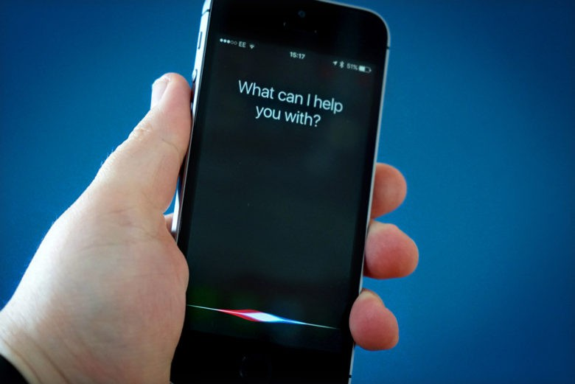
Current Uses of ML?
Machine learning is all around you in day to day life.

Slide 11
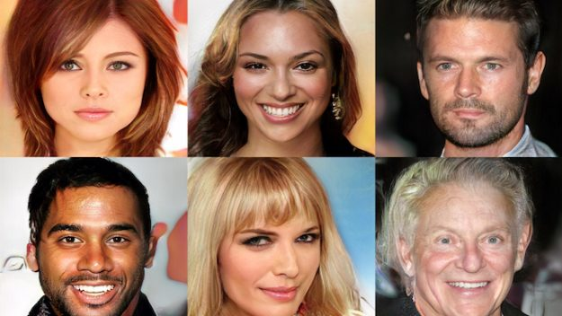
Current Uses of ML?

Slide 12
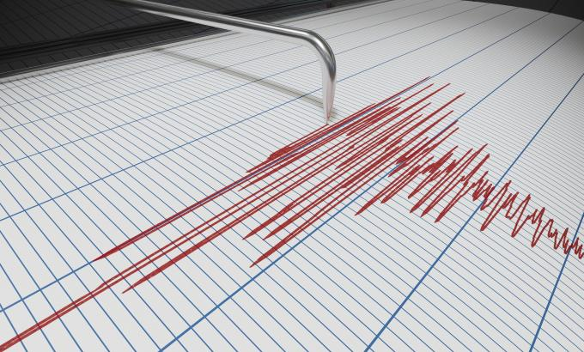
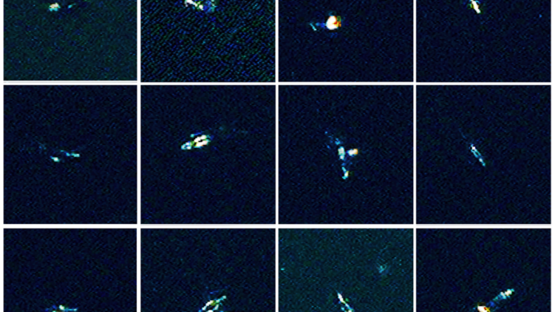
AI and the Environment
Machine learning is already making an impact in environmental sciences.

Slide 13
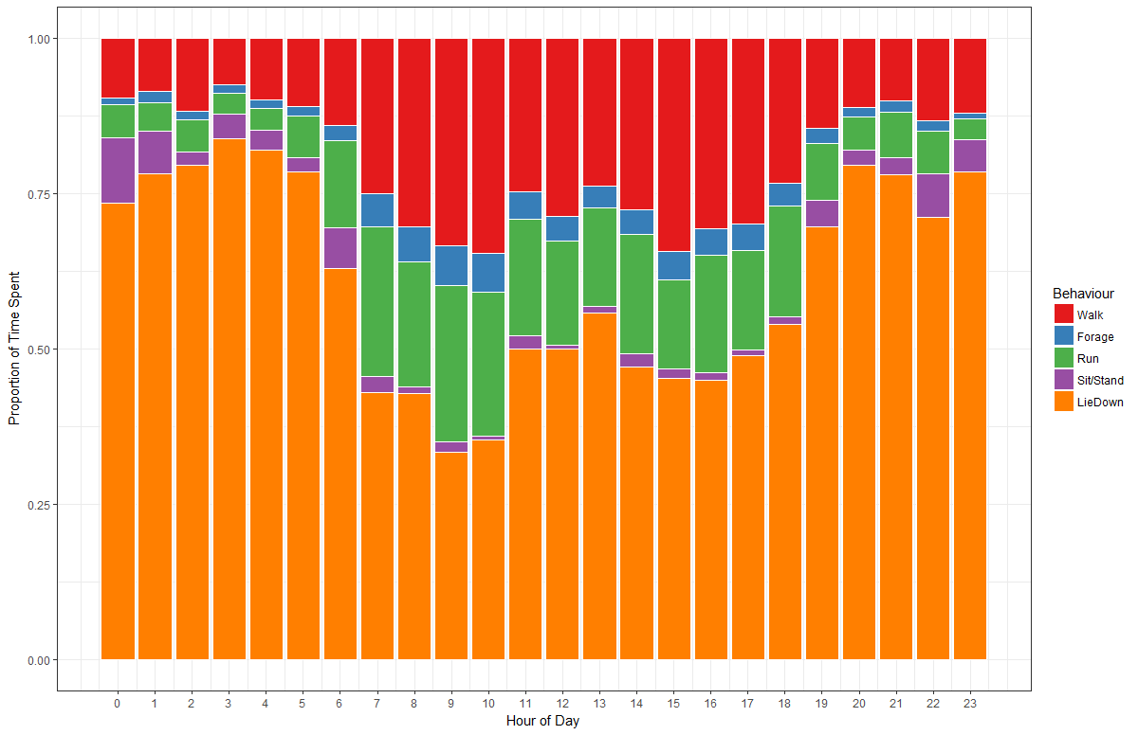
AI and the Environment
Machine learning is already making an impact in environmental sciences.

Slide 14
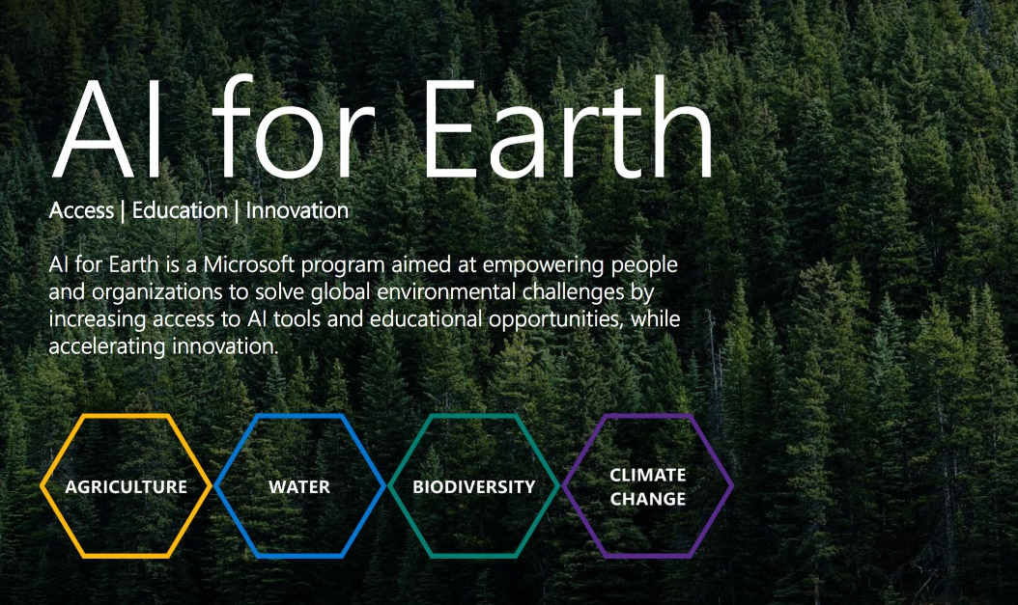
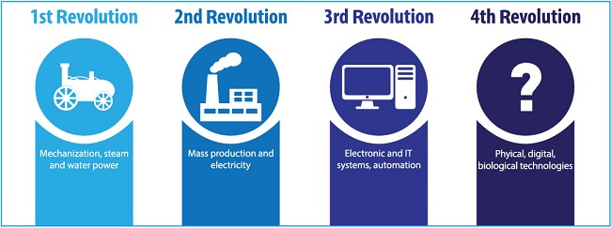
Where is it going?
Machine learning is already making an impact in environmental sciences.

Slide 15
Ok… So how does it work?
Well… The real answer is that it depends on the method you are using.
They each have their own form of underlying maths that makes them but the methods of learning tend to be similar.
Weights and Biases

Slide 16
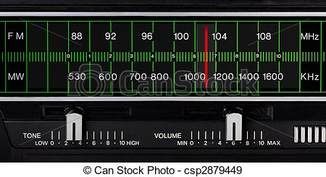
Ok… So how does it work?
But for simplicities sake lets initially think of them as dials and switches tuning the radio.
Dials and Switches

Slide 17
Ok… So how does it work?
But for simplicities sake lets initially think of them as dials and switches tuning the radio.
If I have a radio and want to find a station that is playing classic rock but start at a random frequency I need to tune the dials until I find the correct station.
Every time I change the dials I am listening to a new frequency.
I then need to change the dials in response to that new frequency.
The more wrong the frequency the more I need to change the dial.

Slide 18
Backpropagation
But

